Slide 1
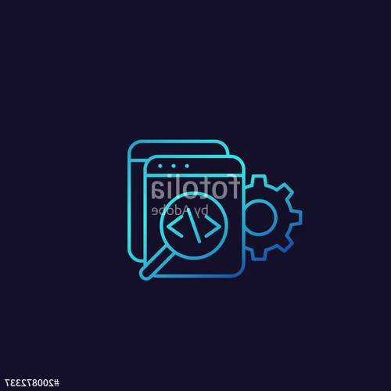
Code Reviews

Slide 2

Code Reviews
code review: A constructive review of a fellow developer’s code. A required sign-off from another team member before a developer is permitted to check in changes or new code.
Analogy: writing articles for a newspaper
  What is the effectiveness of…
  Spell-check/grammar check
  Author editing own article
  Others editing others’ articles

Slide 3
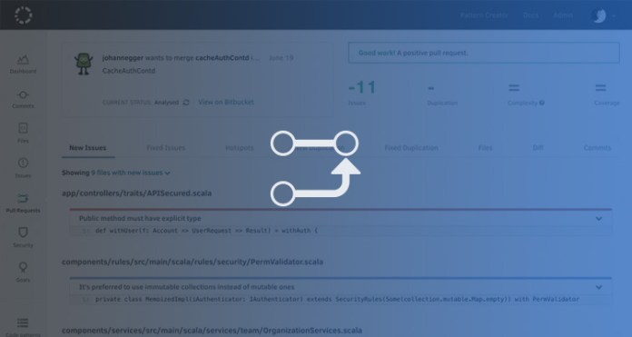
Challenges of Large Code Base
Challenges of large Code Basec
How to ensure…
  Maintainable code?
  DRY code?
  Readable code?
  Bug-free code?
Average defect detection rate for various testing
  Unit testing: 25%
  Function testing: 35%
  Integration testing:45%
  How can this be improved?

Slide 4

Mechanics of code reviews
who: Original developer and reviewer, sometimes together in person, sometimes offline.
what: Reviewer gives suggestions for improvement on a logical and/or structural level, to conform to previously agreed upon set of quality standards.
  Feedback leads to refactoring, followed by a 2nd code review.
  Eventually reviewer approves code.
when: When code author has finished a coherent system change that is otherwise ready for checkin
  change shouldn't be too large or too small
  before committing the code to the repository or incorporating it into the new build

Slide 5

objectifs
Average defect detection rates
  Unit testing: 25%
  Function testing: 35%
  Integration testing:45%
  Design and code inspections: 55% and 60%.
11 programs developed by the same group of people
  First 5 without reviews: average 4.5 errors per 100 lines of code
  Remaining 6 with reviews: average 0.82 errors per 100 lines of code
  Errors reduced by > 80 percent.
IBM's Orbit project: 500,000 lines, 11 levels of inspections. Delivered early and 1 % of the errors that would normally be expected.
After AT&T introduced reviews , study with > 200 people reported a 14 percent increase in productivity and a 90 percent decrease in defects.

Slide 6

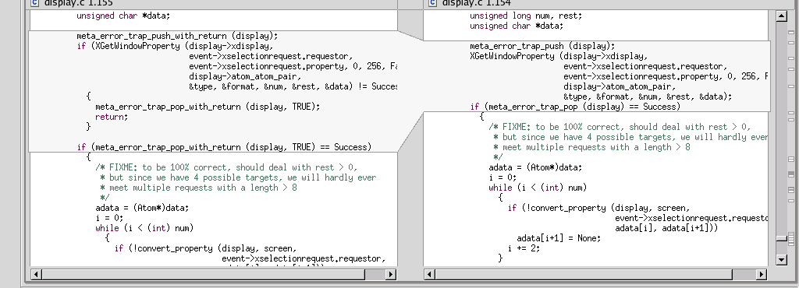
Code reviews in industry
Code reviews are a very common industry practice.
Made easier by advanced tools that:
  integrate with configuration management systems
  highlight changes (i.e., diff function)
  allow traversing back into history
  E.g.: Eclipse, SVN tools

Slide 7

Code Reviews at Google
plus tôt dans le cycle
de vie
du code pour économiser
les coûts3
formation des
développeurs
améliorer la
qualité du
code 2
favoriser la
collaboration, le
travail en équipe2
(appropriation du
code par l’équipe)
appliquer un
standard 2
détecter et corriger les défauts (bugs mais aussi lisibilité) au

Slide 8
